Slide 1
Microsoft Office Excel
CSE 1108
Introduction to Computer Systems

Slide 2
Create new documents from scratch
Search with Microsoft Office Excel
Right Click ⇒ New ⇒ Microsoft Office Excel Document

Slide 3
Save and open previous documents.
Office Button (top left corner) ⇒ Save
Office Button (top left corner) ⇒ Open

Slide 4
Creating PDF and Other Format files from Excel xls.
Office Button (top left corner) ⇒ Save As ⇒ Select Format

Slide 5
Basics
Cell
Row
Column
Address [ADDRESS (row_num, col_num)]

Slide 6
Shortcuts
Copy : ctrl + c
Cut: ctrl + x
Paste: ctrl + v
Bold: ctrl + b
Italic: ctrl + I
Underlined: ctrl + u
Save: ctrl + s
Save as: f12
Open: ctrl + o
Close: ctrl + f4 or ctrl + w
Undo: ctrl + z

Slide 7
Selection
Row: shift+space
Column: crtl+space

Slide 8
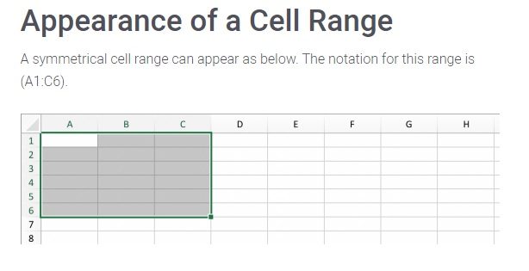
Range
Collection of selected cells.

Slide 9
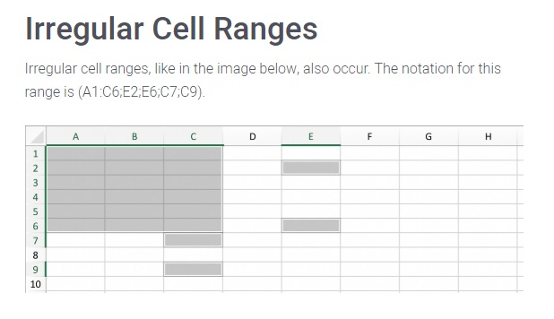

Slide 10
Insert/delete value/row/column.

Slide 11
Page layout, orientation, page size.

Slide 12
Viewing modes and print options.

Slide 13
Pivot Table
A pivot table is a program tool that allows you to reorganize and summarize selected columns and rows of data in a spreadsheet or database table to obtain a desired report. A pivot table doesn't actually change the spreadsheet or database itself.

Slide 14
Formulas
Sum
Average
Minimum
Maximum
Count
Concatenate
Lcm

Slide 15
Ceil and floor functions.

Slide 16
Fill series, user comment.

Slide 17
Wrap text and merge cells.

Slide 18
Shapes and charts, trend line, legends.

Slide 19
Online
Create the CGPA calculation system in excel.
Show result pie and bar chart from given data.

Slide 20
?

